Slide 2
Recipe Management
User Training Manual

Slide 3
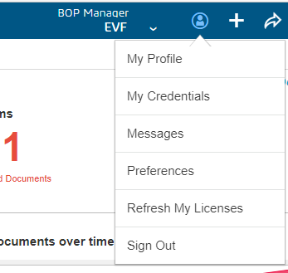
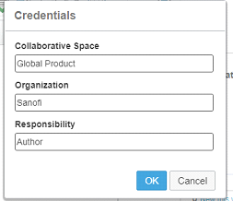
Login to RME
1
2
Login to 3DExp and go to home page
Go to profile symbol.
Click on My credentials .
Verify credentials as per Access Matrix
Note:- RME Users As per Access Matrix sheet
Recipe Manager (General)
Recipe Manager (Platform)
Recipe Manager (Site,Master)
Material Manager
3
internal use
3

Slide 4
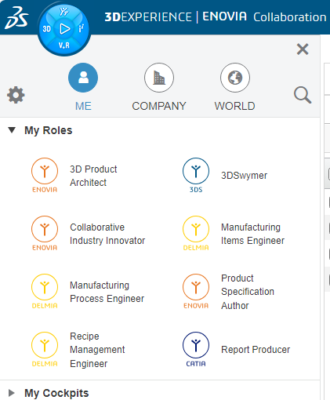
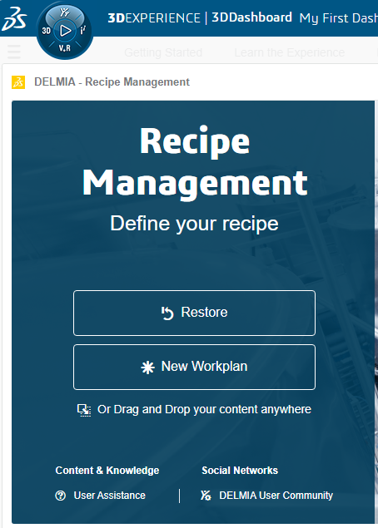
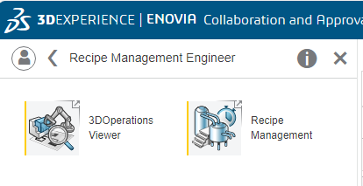
Roles and Apps
1
4
Click on compass
Select Recipe Management Engineer Role.
Select Recipe Management.
Recipe Management page displays with Restore & New Workplan
Click on Restore
Note Recipe Structure is created By Recipe Manager (platform)
2
5
3

Slide 5
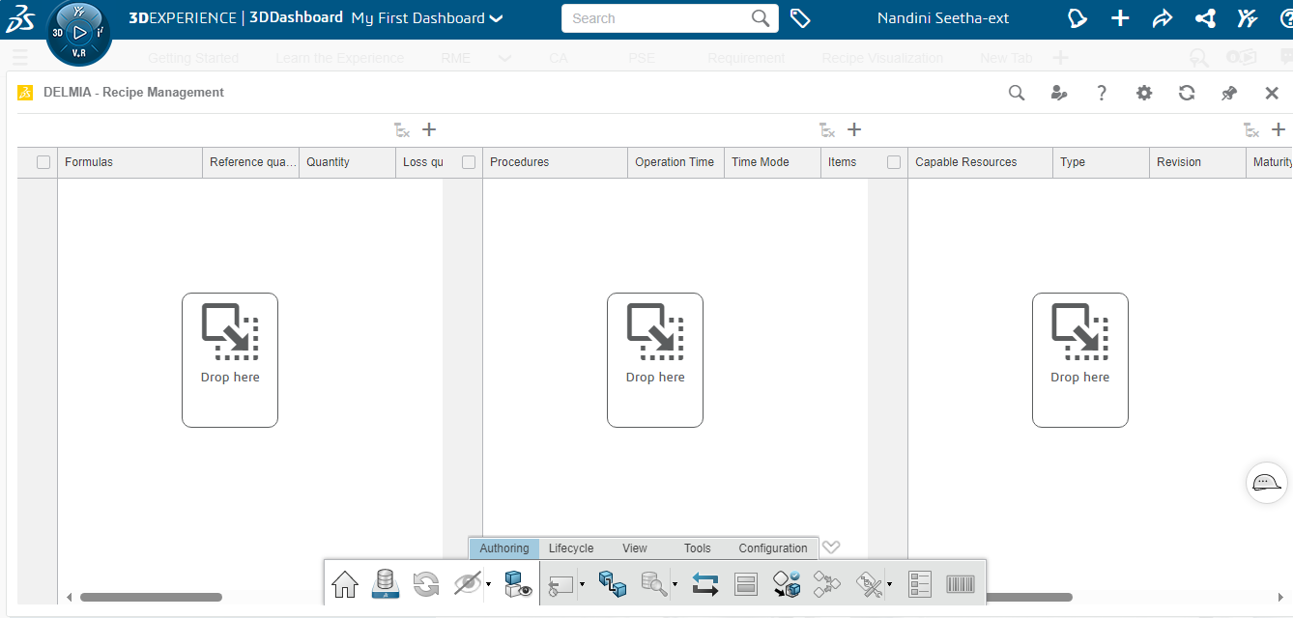
Access to Recipe Management Application
Page displays vertically with following Tabs
Formulas Tab
Procedures Tab
Capable Resource Tab
1
2
3

Slide 6
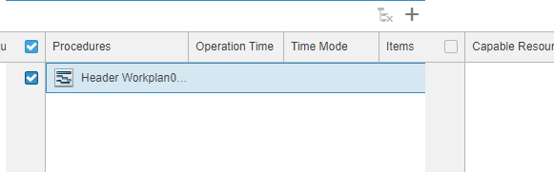
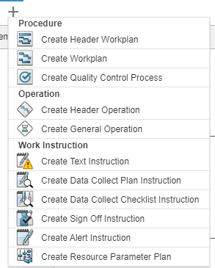
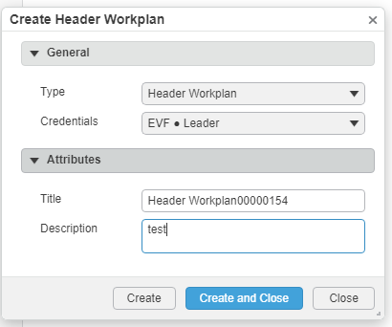
Creation Of Process name - level 0 (Header Workplan)
1
Under Procedures Tab create level 0 Header workplan
Select "+" Icon which is at top of Procedures Tab
Creation tab pop's up with Procedures, Operation , Work Instruction.
Select "create Header Workplan" under procedures
Create Header workplan Dialogue box pop's up with following metadata (Title & Description)
Edit Title & Description , click on create and close
User created Header workplan level 0.
2
4
3
5

Slide 7
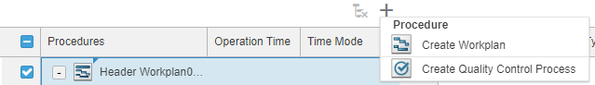
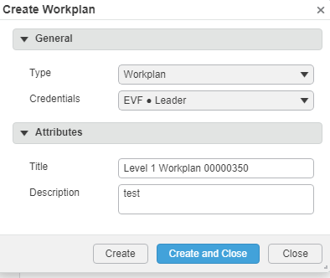
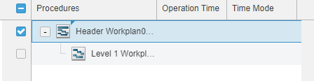
Creation Of Process Step - level 1 (Workplan)
1
Select Created Header workplan and go to "+" Icon which is at top of Procedures Tab
Select "create Workplan" under procedures
Create workplan Dialogue box pop's up with following metadata (Title & Description)
Edit Title ,Description , click on create and close
User created workplan level 1 under level 0.
Note :- user is able to create Multiple Workplans under level 0 Header workplan.
2
3
4
5

Slide 8
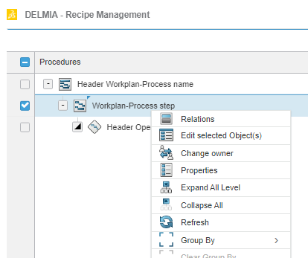
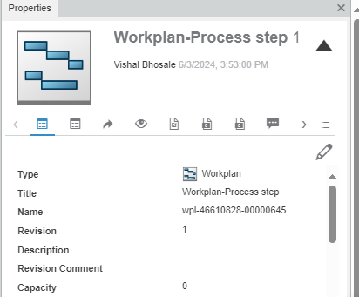
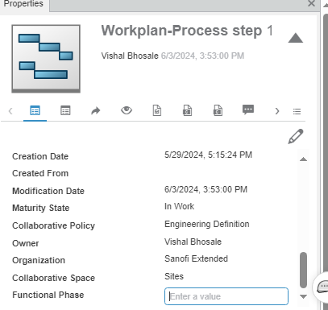
Add Functional phase information to process step
IIEPLM-2058
In the procedure view select Process step – workplan system in the process structure
Right click and select properties
In the properties window click on Edit
Scroll down and in the Functional phase attribute type the relevant functional phase name.
1
2
3
4

Slide 9
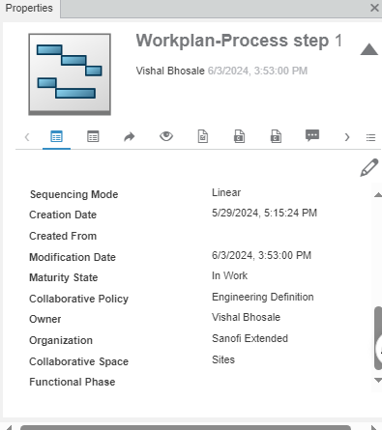
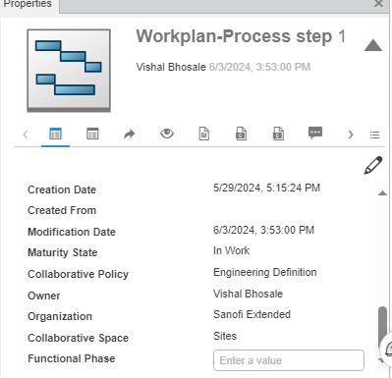
Modify Functional phase information in Recipe
IIEPLM-2059
In the procedure view select Process step – workplan system in the process structure
Right click and select properties
In the properties window check maturity state as “IN Work”
Click on Edit
Modify the Functional phase detail.
1
2
4
3
5

Slide 10
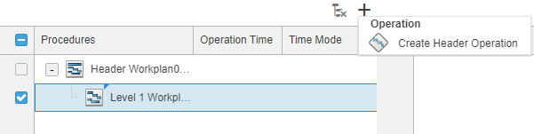
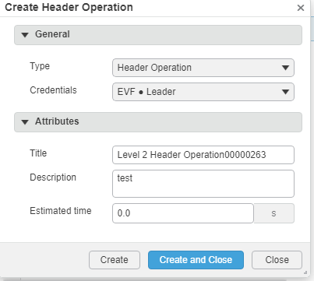
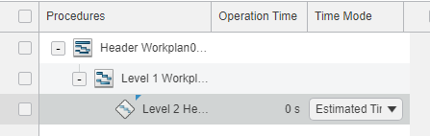
Creation Of Process Operation - level 2 (Header Operation)
1
2
Select Created Level 1(workplan) and go to "+" Icon which is at top of Procedures Tab.
Select "create Header operation".
Create Header operation Dialogue box pop's up with following metadata (Title & Description).
Edit Title ,Description , click on create and close.
User created Header Operation level2 under level-1
Note user is able to create Multiple Header operations under workplan level 1
3
4
5

Slide 11
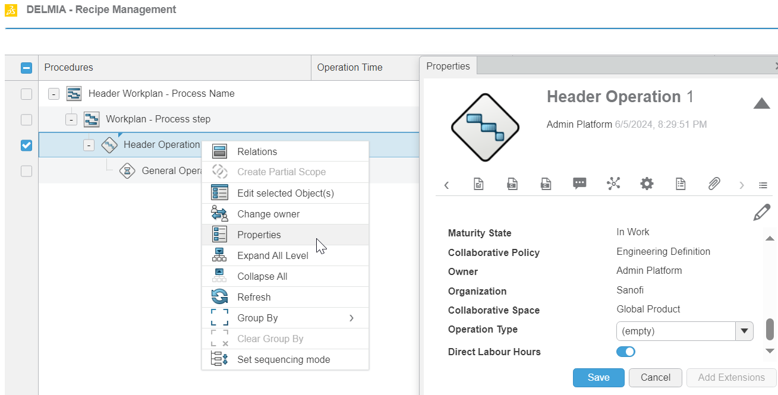
Add Direct Labour Hours
select ‘Header Operation’.
Right click and select Properties
On Header Operation properties page click on Edit symbol
Select or de-select the value of form field ‘Direct Labour Hours’ and click on Save
1
3
2
4

Slide 12
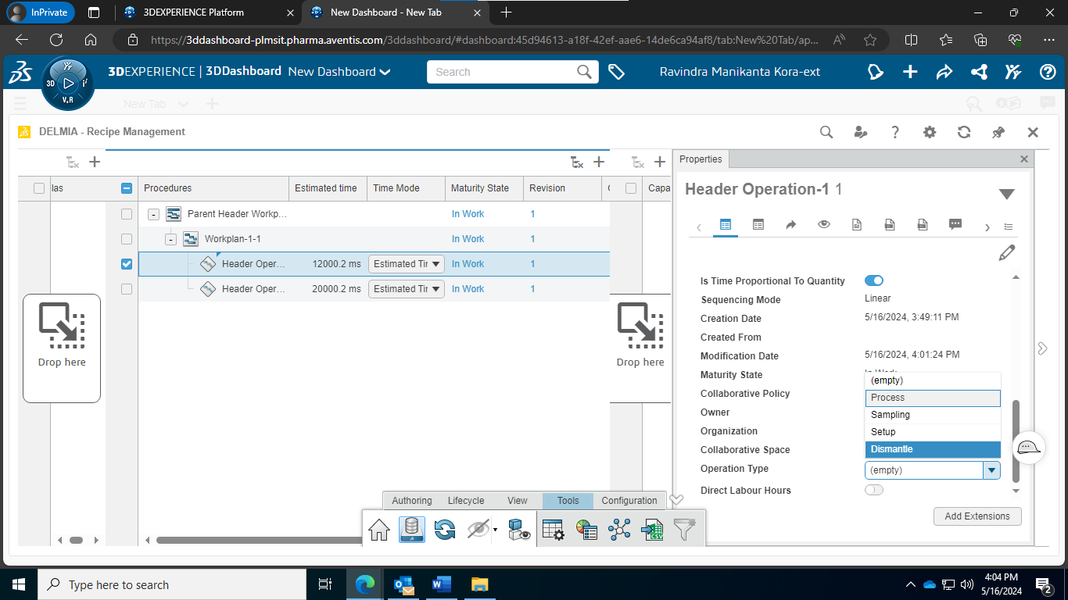
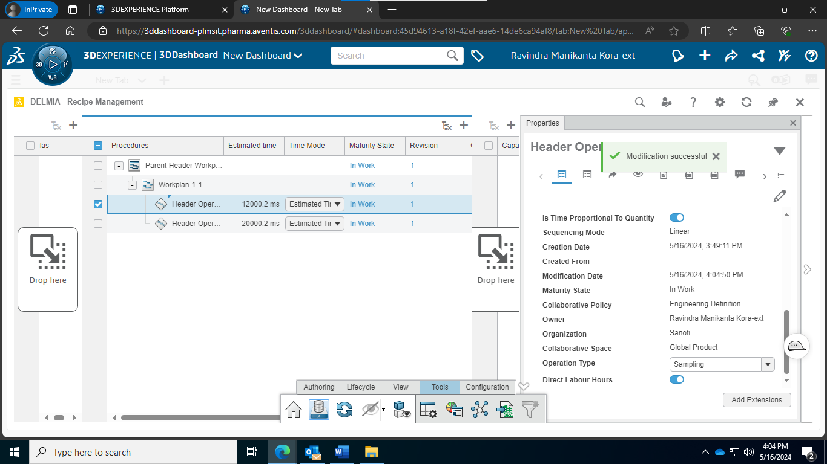
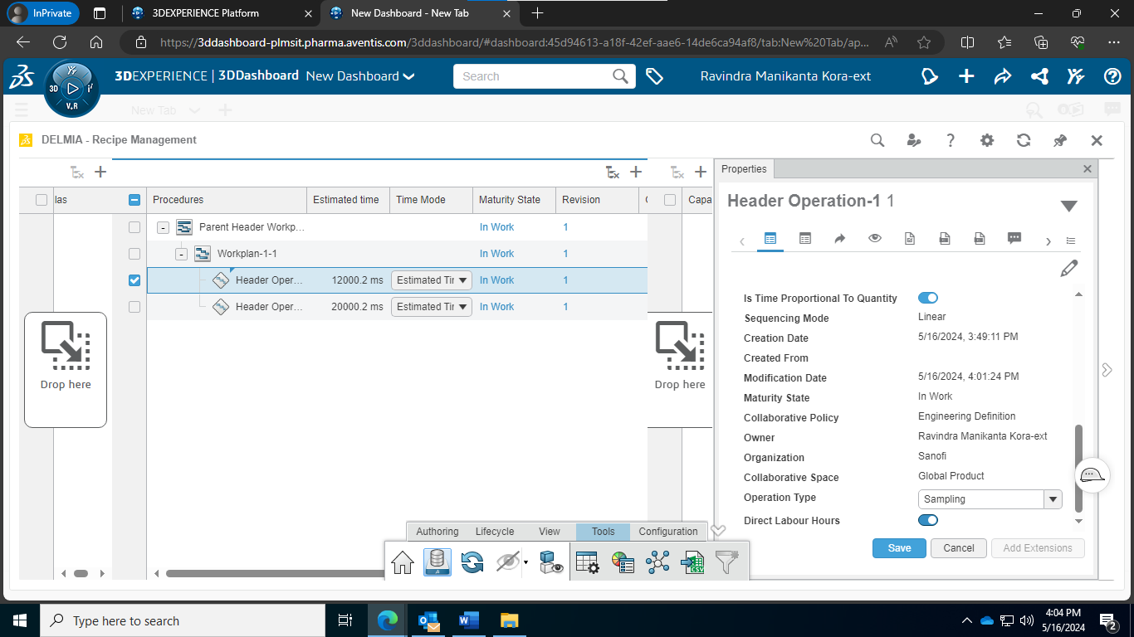

Select Operation Type
Open Header operation properties page, in go to operation type click on drop down and verify picklist values like Setup, process, Sampling, dismantle.
Select the value from the dropdown that is required.
Selected operation type will be assigned to the operation.
1
2
3

Slide 13
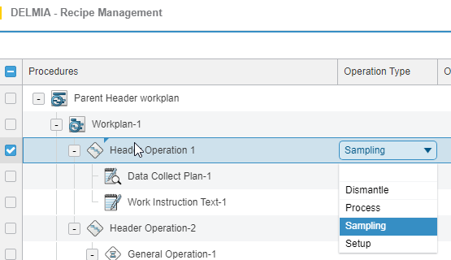
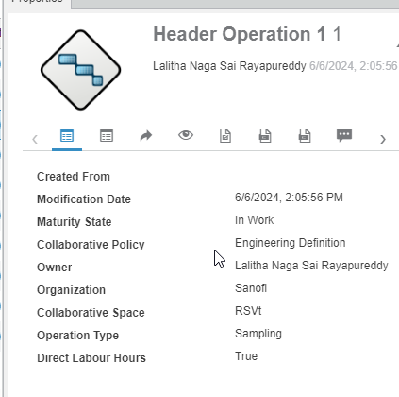
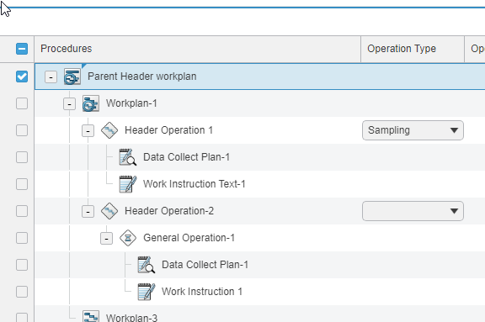
Visualize operation Type and Assign sample output material to Sampling
IIEPLM-2052
In the operation type will have setup, process, dismantle, sampling values in the dropdown.
Select the value Sampling from the dropdown.
Sampling operation type will be assigned to the operation.
1
3
2

Slide 14
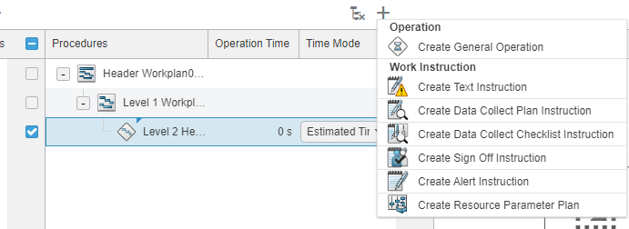

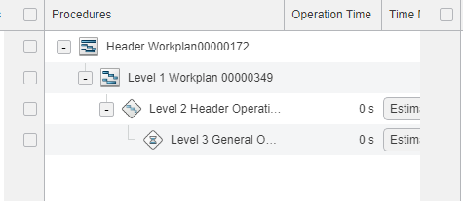
Creation Of Process Operation Task - level 3 (General Operation)
1
Select Created Header Operation and go to "+" Icon which is at top of Procedures Tab.
Under Operation Select "create General operation".
Create General Operation Dialogue box pop's up with following metadata (Title & Description).
Edit Title ,Description , click on create and close.
User created General Operation level3 under level 2.
Note :- User is able to create Multiple General operations.
2
3
4
5

Slide 15
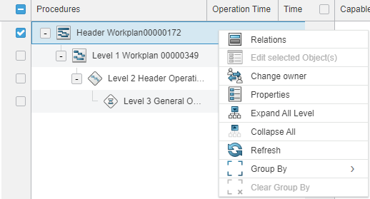
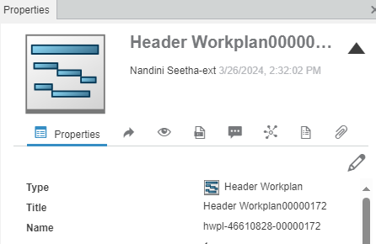
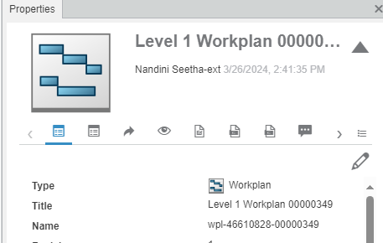
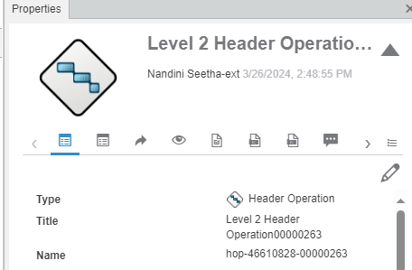
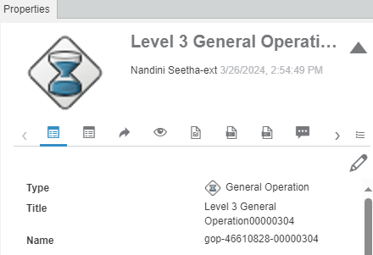
Verify Unique Id Of All Levels
Select Created Header Workplan and go to properties
Under properties page verify unique id generated with name hwpl.
Select Workplan and verify Unique id generated with name wpl.
Select Header Operation and verify Unique Id generated with hop.
Select General Operation and verify unique id generated with name gop.
1
1
2
3
5
4

Slide 16
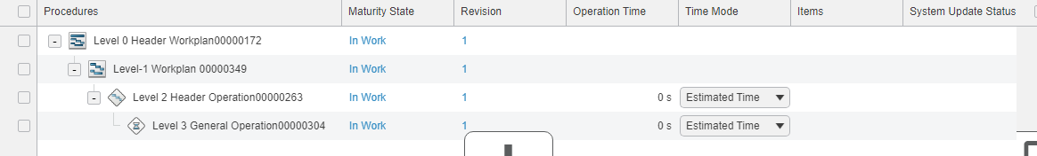
Verify Revision Value and Maturity state of all levels
Expand procedures tab and scroll right
Under revision column verify numeric value
Under Maturity column Verify Maturity state of all levels in In-Work
2
3
1

Slide 17
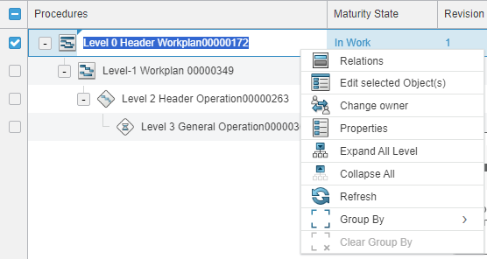
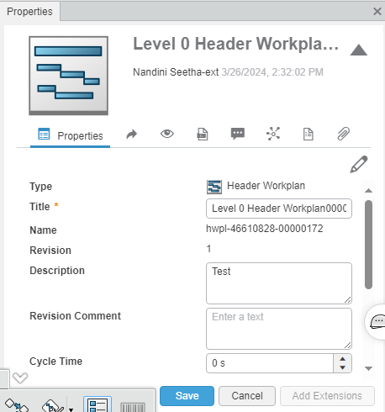
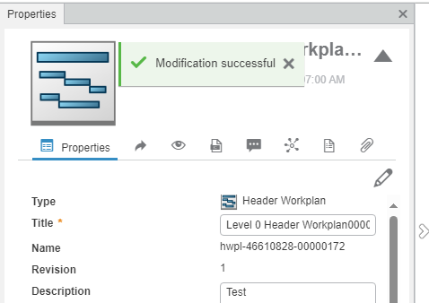
Update Meta Data Information of process (All levels)
1
Select Header Workplan (Level-0) Go to Properties
Under properties page click on edit symbol
Edit title and Description click on save.
Metadata information updated successfully
1
4
2
Same steps to update metadata information for
Level-1 (Process step)
Level-2 (Process Operation
Level-3 (Process operation Task
3

Slide 18
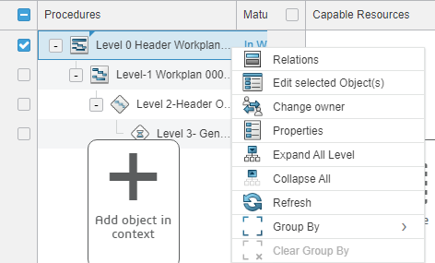
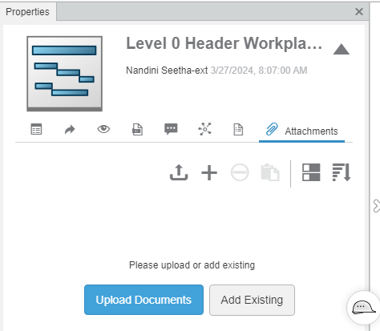
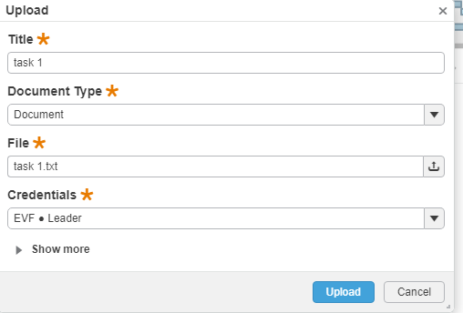
Attach Documents and Remove Document at Level 0 (Header workplan)
2
1
Select Level 0 and go to properties
Under properties page go to Attachments click on upload document
Select document from system(Note pad, pdf, Excel) and verify Upload document dialogue box is pops up and click on upload.
3

Slide 19
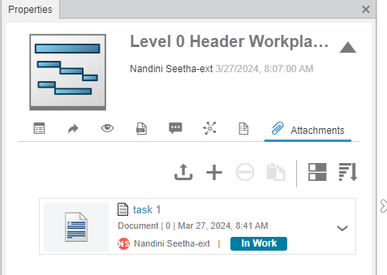
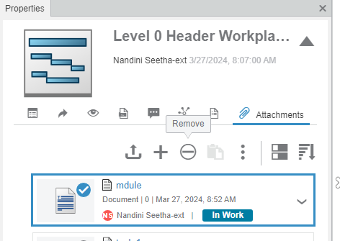
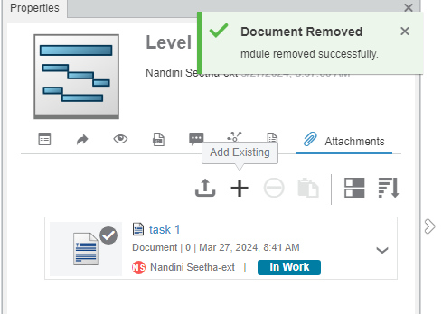
Attach Documents and Remove Document at Level 0 (Header workplan)
4. Document got uploaded
5.Upload one more document and Click on remove
6. Document is removed.
4
6
5

Slide 20
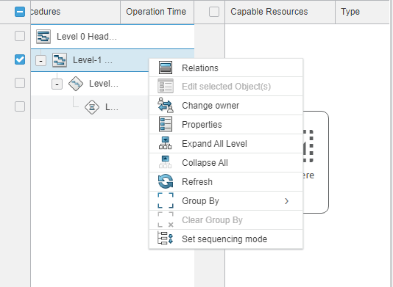
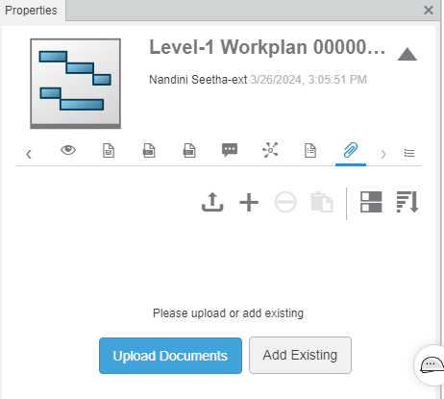
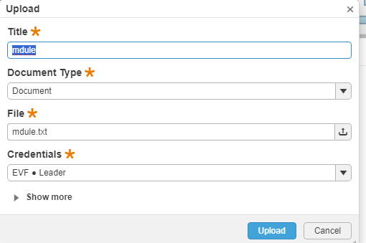
Attach Documents and Remove Document at Level 1 ( workplan)
1
2
Select Level 1 and go to properties
Under properties page go to Attachments click on upload document
Select document from system(Note pad, pdf, Excel) and verify Upload document dialogue box is popes up and click on upload.
3

Slide 21
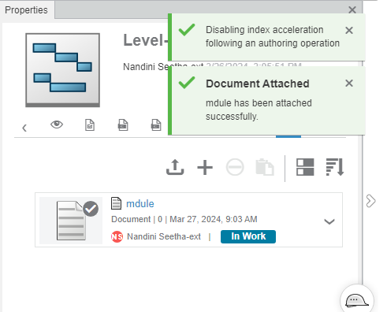
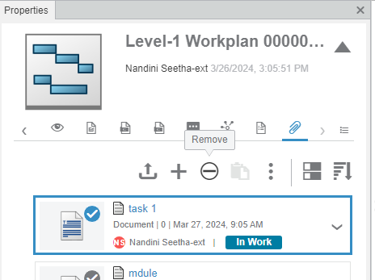
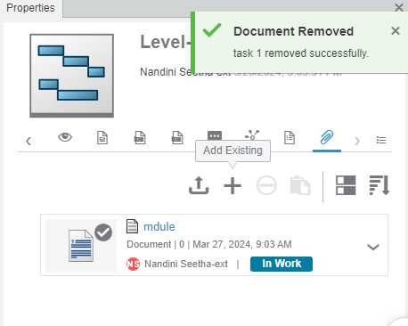
Attach Documents and Remove Document at Level 1(workplan)
4
4. Document got uploaded
5.Upload one more document and Click on remove
6. Document is removed.
6
5

Slide 22



Attach Documents and Remove Document at Level 2(Header operation)
Select Level 2and go to properties
Under properties page go to Attachments click on upload document
Select document from system(Note pad, pdf, Excel) and verify Upload document dialogue box is popes up and click on upload.
2
1
3

Slide 23



Attach Documents and Remove Document at Level 2(Header Operation)
4. Document got uploaded
5.Upload one more document and Click on remove
6. Document is removed.
4
6
5

Slide 24



Attach Documents and Remove Document at Level 3(General operation)
1
Select Level 3 and go to properties
Under properties page go to Attachments click on upload document
Select document from system(Note pad, pdf, Excel) and verify Upload document dialogue box is pops up and click on upload.
2
3

Slide 25



Attach Documents and Remove Document at Level 1(workplan)
4
4. Document got uploaded
5.Upload one more document and Click on remove
6. Document is removed.
6
5

Slide 26




Navigate to All levels
1
Select Created Header workplan and right click on it select expand all
Strcuture expanded from top to bottom
Select Top node (Header workplan) right click on it select Collapse All.
Structure got collapsed
2
4
3

Slide 27



Remove Level 3 (General Operation) From Level 2 (Header Operation)
1
Select General operation and click on Detach which is at top of Procedures tab
Detach Dialogue box popup and click on OK.
Level 3 (General operation) got removed from level 2 (Header operation)
2
3

Slide 28



Remove Level 2 (Header Operation) From Level 1 (Workplan)
1
Select Header operation and click on Detach which is at top of Procedures tab
Detach Dialogue box popup and click on OK.
Level 2 (Header operation) got removed from level 1 (Workplan)
2
3

Slide 29



Remove Level 1 (Workplan) From Level 0 (Header Workplan)
1
Select Workplan and click on Detach which is at top of Procedures tab
Detach Dialogue box popup and click on OK.
Level 1 (Workplan) got removed from level 0(Header Workplan)
2
3

Slide 30


Add multiple operation to process step
Select Created workplan
Click on + button & Select Create header operation to create process operation under process step
In create header operation window add Title& description
Click on Create & close.
2
1
3
3
4
5
4

Slide 31


Assign & modify Estimated time to Process operation
1
2
Select process operation level to which cycle time to be assigned/modified.
Right click and Select properties
Click on edit button and enter the time in the estimated time field.
3
3

Slide 32



Creation of Data Collect Plan
Select General Operation Go to + icon Add recipe Item and Select Data collect plan Instruction
Edit Title and Description click on create and close
Data Collect plan is created
Note :- If data Collect plan is created under Header operation, unable to create General operation
Data collect plan is created under Last of the Opeartion.
1
2
3

Slide 33


Configure process parameter(Edit data Collect Plan Row)
1
2
Go to Edit plan and click on +icon Create Data Collect Row dailoge box opens.
Select the Type,Magnitude and unit of measure and add value for selected process parameter associated to operation
Define minimum/maximum values for the target value assigned to process parameter associated to operation
3

Slide 34


Add criticality to process parameter
1
Add criticality to process parameter(Data collect Row) 1. Select the data collect plan row. 2. Edit Data collect plan dialog box pop ups, 3. Update Label value as 'CPP' 4. Click on ok. Repeat instruction mentioned 1 to 4 to update Process Parameters of each type(Integer, Text, Boolean, Timestamp) and fill unique criticality values(CPP, KPP, PP) for each type.
2
3
4

Slide 35

De-Link Process Parameter from Operation
1 . Click on the Check Box for the required parameter. 2 . Click on the Delete Icon.
2
1

Slide 36



Creation of Resource Parameter Plan
Select General Operation Go to + icon Add recipe Item and Select Resource Parameter plan.
Edit Title and Description click on create and close
Resource Parameter plan is created
1
3
2

Slide 37



Creation of Text Instruction
1
Select General Operation Go to + icon Add recipe Item and Select Create Text Instructions
Edit Title and Description click on create and close
Text Instruction is created
2
3

Slide 38

Navigate to Recipe Library
Go to 3Dspace click on compass & search for Ip classify & Reuse
Navigate to below Path
Libraries>Recipe Library>Global Library>Techno Platform

Slide 39

Add Recipe in Techno Platform
Go to RM Tab select created Recipe drag and drop it to Techno Platform
Recipe is added In Techno Platform
Note:- user with Required role(Rm(Platform)) can add Recipe in Relevant library

Slide 40

Add Recipe in Generic Recipe
Navigates to below Path
Recipe Library > Global Library > Generic Recipe
Drag and Drop Recipe under Generic Recipe
User added Recipe In Generic Recipe
Note:- user with Required role(RM(General)) can add Recipe in Relevant library

Slide 41

Add Recipe in Master Recipe
Navigates to below Path in IP Classify & Reuse
Recipe Library > Local Library > Master Recipe
Drag and Drop Recipe under Master Recipe
User added Recipe In Master Recipe
Note:- user with Required role(RM(site,Master)) can add Recipe in Relevant library

Slide 42

Add Recipe in Site Recipe
Navigates to below Path
Recipe Library > Local Library > Site Recipe
Drag and Drop Recipe under Master Recipe
User added Recipe In Site Recipe
Note:- user with Required role(RM(site,Master)) can add Recipe in Relevant library

Slide 43


Verify Recipe Type, Recipe level & Recipe Usage
2
Go to RM tab and select Recipe Right click on it go to properties
On properties Page Verify Site Recipe classification is Visible
Click on edit symbol
Verify Recipe Type ,Recipe Level and Recipe Usage Edit Recipe type & Usage.
1
3

Slide 44



Creation of Capable Resources
1
Under capable resource Tab create Manufacturing cell, Industrial Machine, and Tool Equipment's.
Click on + icon add resource items and select Create Manufacturing cell
Create Manufacturing cell dailouge box opens click on create and close
Manufacturing cell is created
2
3

Slide 45



Creation of Capable Resources
Select Manufacturing cell and click on + icon and Select Create Tool Equipment
Create Tool Equipment Dailouge box opens, click on create and close
Tool Equipment is crated
1
3
2

Slide 46



Create Automation Resource
Search for software resource and drag and drop under the tool equipment.
Right click on the software resource and go to properties page and expand Software Resource Attribute and click on the edit button.
Go to Resource type and select Automation from the drop down.Click on 'Save' button.
2
1
IIEPLM-2369
3

Slide 47


Equipment Requirement # Software requirement
Create Manufacturing cell under capable resources.
In the global search bar search for software resource and drag and drop under the tool equipment.
Right click on the software resource and go to properties page and expand Software Resource Attribute
Contains the following information Resource Name, Resource Version and Resource Type
1
3
2
4
3

Slide 48




Creation of resource parameter list
Select Tool Equipment and open Properties page under properties page click List items and select Resource Parameter.
Click on + button
In the resource parameter list window add name and description of parameter. Click on create.
Resource parameter list created.
2
1
3
4

Slide 49


Resource parameter Value ranges
From the resource parameter list window select resource parameter
Click on + button.
Temperature parameter window opened.
Add the name and description.
select direction (input parameter or output parameter)
Select parameter type from the pick list (select other and type temperature → select temperature to set type)
Add minimum and maximum target values for the selected parameter
Select required unit
Click on create.
3
4
5
6
8
7
7
9

Slide 50


Modify metadata of the Resource parameter in the recipe
Select "Resource parameter and click on Edit
Update Resource Parameter dailouge box opens
modify resource parameter list name and description and click on save.
1
2
3

Slide 51




Search Equipment
Search Equipment using common name. User is able to visualize the list of Equipment's in search window.
Drag and drop the related Equipment to capable resource under Manufacturing cell.
Select Equipment which is added and Drag drop it to Header operation
select operation and open Relations Tool equipment is added to Header operation
As a user option should be available to unlink
the associated material.
5
1
2
3
4

Slide 52



Add Multiple Equipment's
Select Tool Equipment , Drag and drop to Header operation , click on Primary / Secondary capable Resource
Drag and drop one more Tool equipment
Verify Multiple Equipment's associated to Operation
1
3
2

Slide 53



Remove Associated Equipment
Click on the Tool Equipment attached to the operation.
Click on 3 lines and select Delete link
Equipment is removed from Operation
1
2
3

Slide 54




Assign Resource Parameter plan
2
Select Resource parameter plan Right click on it. Select Edit plan
Click on + icon and select Resource parameter. Click on Set/Get
Resource parameters values are displayed in Resource parameter plan.
1
3
4

Slide 55


Create Material structure
1
Under Formulas Tab Click on + icon and Select "Create Continuous manufactured material"
Enter the name of the materials in the Title field
Click on Create and Close
2
3

Slide 56



Add Multiple Materials
1
Create Multiple Continuous Manufactured materials and Continuous Provided Materials in formulas tab
Select materials from the structure and add to the Recipe structure.
Drag and drop the multiple selected Provided materials from material structure to an operation.
2
3

Slide 57



Visualize Link between Media and Media consumed in Recipe
2
Select anyone of the Material ,go to Authoring and select create Link
Create Link dialog box opens and select Operation
Click on Implement/ output Link
Scope Link is created
1
4

Slide 58



Open material metadata in new window
Click on the material added to Header operation / workplan, Click on "Add Object to Aux View"
Material is added to Aux view and Click on Explore In WebApp
3. Material metadata is opened in new window
1
2
3

Slide 59




Search Materials
Search Materials using common name. User is able to visualize the list of materials in search Result.
Drag and drop the related materials from Manufactured Item structure to an operation under recipe structure.
Select operation in In-work status and UI should display the associated materials in relation pannel.
Click on material and click on 3 lines select delete Link ,material is removed from operation.
1
2
3
4

Slide 60


Remove associated Material
Select Header Operation, Go to items column Select anyone of the Material Linked to Header Operation.
Right click on Header operation and select Relations
Material Relation tab is opened and click on 3 lines, Select Delete Link
Verify user is able to Delink Material from Header Operation
1
2
3

Slide 61




Update Material Quantity
Create Continuous Manufactured Material in Formulas tab and Create Provided part from Manufacturing Items Engineer app
Drag and drop the created Provided part to Continuous Manufactured Material in formulas tab in RME app
Right click on the properties of Provided part and select instances tab and edit the properties
Select unit row and user can see list of values and update quantity.
3
4
2

Slide 62




Add SUA/Consumable to continuous Materials
Go to Global Search and search for SUA Consumable by its common name from the data base
Drag and drop to Continuous manufactured material in Formulas section of RME tab.
Verify Recipe Manager successfully search a SUA Consumable and added to Continuous manufactured material
Repeat step 1 to 3 to create multiple SUA to continuous material
1
2
3

Slide 63




Remove associated SUA/Consumables associated to Header Operation
1
Select Header operation ,Right click on it Select Relations
Relation tab is opened ,Go to SUA click on 3 lines and select delete link
verify user is able to delink the associated SUA under Header Operation.
2
2
3

Slide 64



Add SUC/Consumable to continuous Materials
1
Go to Global Search and search for SUC Consumable by its common name from the data base
Drag and drop to Continuous manufactured material in Formulas section of RME tab.
Verify Recipe Manager successfully search a SUA Consumable and added to Continuous manufactured material
3
2

Slide 65



Material Management
1
Navigate Material Library
Click on compass & search for Ip classify & Reuse
Click on ‘IP Classify & Reuse’
Navigate to Path: Libraries -> Recipe Library -> Material Library
Material Library have 5 classifications
Drug Substance
Intermediate
Output Material
Raw Material
Sample
1
3
4
2

Slide 66



Add Continuous Manufacturing Material in Drug Substance
1
Navigates to below Path in IP Classify & Reuse
Material Library > Drug substance
Drag and Drop Continuous Manufactured Material under Drug Substance
User added Continuous Manufactured Material in Drug substance
Note:- Materials should be added to Material classification by Rm (platform)
2
3

Slide 67


Verify Drug Substance Attributes
1
Click on ‘Drug Substance’ material library classification
Select Material , right mouse click and select Information
Verify Drug substance Attributes
Note:- Materials should be added to Material classification by Rm (platform)
2
3

Slide 68



Add Continuous Manufactured Material in Intermediate
1
Navigates to below Path in IP Classify & Reuse App
Material Library > Intermediate
Drag and Drop Continuous Manufactured Material under Intermediate
User added Continuous Manufactured Material in Intermediate
Note:- Materials should be added to Material classification by Rm (platform)
2
3

Slide 69

Verify Intermediate Attributes
2
1
Click on ‘Intermediate’ in material library classification
Select Material , right mouse click and select Information
Verify Intermediate Attributes
Note:- Materials should be added to Material classification by Rm (platform)
3

Slide 70



Add Continuous Manufactured Material in Output Material
1
2
Navigates to below Path in IP Classify & Reuse app
Material Library > Output Material
Drag and Drop Continuous Manufactured Material under Output Material
User added Continuous Manufactured Material in Output Material
Note:- Materials should be added to Material classification by Rm (platform)
3

Slide 71


Verify Output Material Attributes
Click on ‘Output Material’ in material library classification
Select Material , right mouse click and select Information
Verify Output Material Attributes
Note:- Materials should be added to Material classification by Rm (platform)
2
1
3

Slide 72



Add Material in Sample
1
Navigates to below Path in IP Classify & Reuse app
Material Library > Sample
Drag and Drop Material Continuous Manufactured Material under Sample
User added Material Continuous Manufactured Material in Sample
Note:- Materials should be added to Material classification by Rm (platform)
2
3
IIEPLM-2364

Slide 73


Verify Sample Attributes
Click on ‘Sample’ in material library classification
Select Material , right mouse click and select Information
Verify Sample Attributes
Note:- Materials should be added to Material classification by Rm (platform)
1
2
3

Slide 74




Create Continuous Provided Material In Manufacturing Items
1
3
Go to 3dspace click on Compass
Select Manufacturing Items Engineer
Select Manufacturing Items Management
Click on Restore
Manufacturing items Page is
Opened
Note:- Mfg.items is accessd by Material Manager
2
5
4

Slide 75



Create Continuous Provided Material In Manufacturing Items
7
6. Go to Authoring and select create Continuous Provided Material
7. Create Continuous Provided Material dialog box opens, edit the title and click on Create and Close
8. Continuous Provided Material is Created in Manufacturing Items Tab.
Note:- RawMaterial is added by Recipe Manager (site, Master)
6
8

Slide 76



Navigate to Material Library Add Material in Raw Material
IIEPLM-2353
2
Navigates to below Path in IP Classify & Reuse
Material Library > Raw Material
Drag and Drop continuous Provided Material under Raw Material
User added Continuous Provided Material
Note:- RawMaterial is added by user Material Manager
1
3

Slide 77


Verify Raw Material Attributes
2
Click on ‘Raw Material’ in material library classification
Select Material , right mouse click and select Information
Verify Raw Material Attributes
1
3

Slide 78




Duplicate Recipe
2
1
Select Recipe Structure
Go to Lifecycle And select Duplicate option From bottom
Duplicate Dialog Box opens
Select Advanced Duplicate
3
4

Slide 79



Duplicate Recipe
6
5
5. Duplicate Recipe Dialog box opens
6. Select all the Required options
7. Click on Duplicate
8. Recipe Structure is Duplicated
6
8
7

Slide 80



Duplicate Material
1
Select Material Structure
Go to Lifecycle And select Duplicate option From bottom
Duplicate Dialog Box opens
Select Advanced Duplicate.
2
3
4

Slide 81



Duplicate Material
5
8
5. Duplicate Material Dialog box opens
6. Select all the Required options
7. Click on Duplicate
8. Material Structure is Duplicated.
6
7

Slide 82




Compare Recipe
Select Original and Duplicated Recipe
Go to Lifecycle and select Compare Option
Compare dialog box opens click on compare
Compare original & duplicated Recipe.
1
2
3
4

Slide 83




Compare Material
1
2
Select Original and Duplicated Material
Go to Lifecycle and select Compare Option
Compare dialog box opens click on compare
Compare original & duplicated Material
3
4

Slide 84






Equipment Fit Analysis
Navigate to equipment type in path Technical Library -> Process Equipment -> Bioreactor
Click on ‘Advance Search Within’
Select the Equipment attributes from drop down
Select match criteria
Enter/select the value and click on Search
Search result displays the matching criteria data
1
2
4
5
3
6

Slide 85





Report Generator
Go to report generation app and click on hamburger icon and select create report option. Enter a Name to the report and select template and output format for the respective fields, then click on next and select the preferred header workplan and click on done. Report gets created now click on the check box of the report and navigate to hamburger icon and click on generate. Report gets generated in some time, then click on the download symbol to download the report. Report gets downloaded.
2
1
3
5
4

